Slide 1
AI Application for SAP Transaction
Solution Outline of sales order processing with Artificial Intelligence

Slide 2
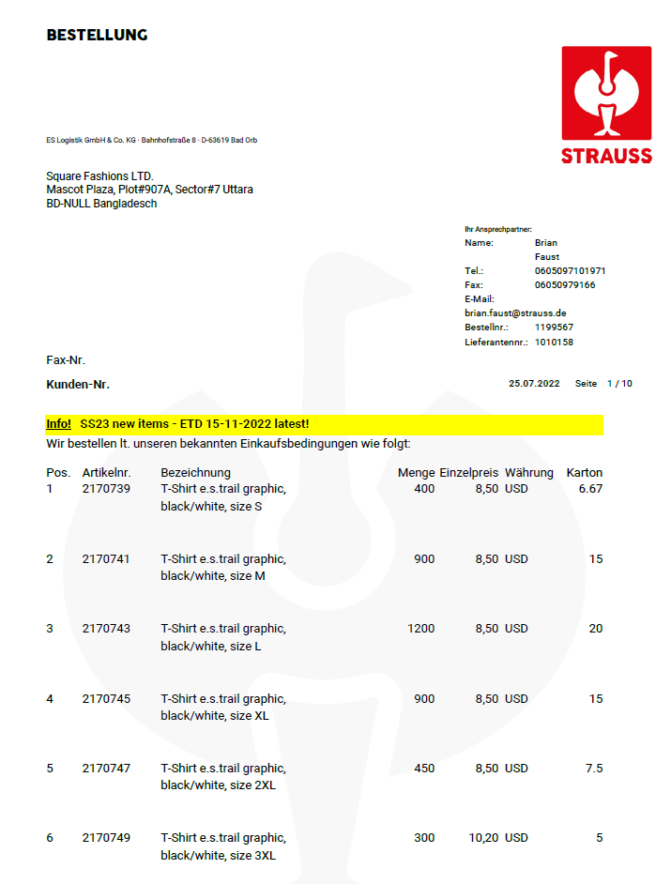
The STRAUSS PO
Takes PO (PDF) as inputs
Saves in the database
Python Camelot library
Read texts & tables
Provides extract as JSON file

Slide 3
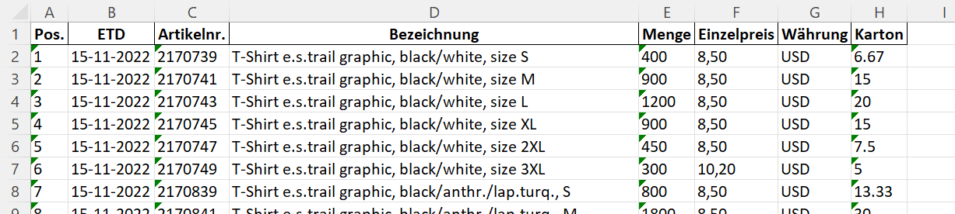
The Raw Extract
Convert JSON file into excel
Style, colour & size in 1 column
Split them into separate columns

Slide 4
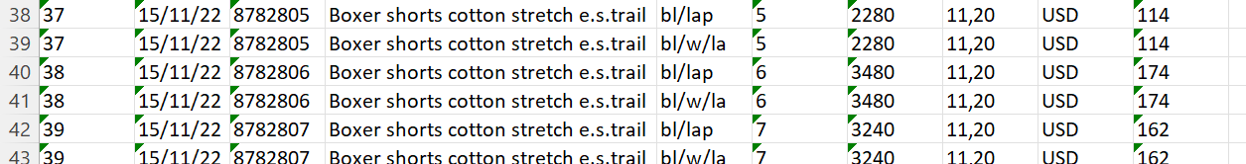
The styles having pack
Check for styles having pack
Get the number of the pack
Copy them into new rows while segregating colours by ‘+’ sign

Slide 5
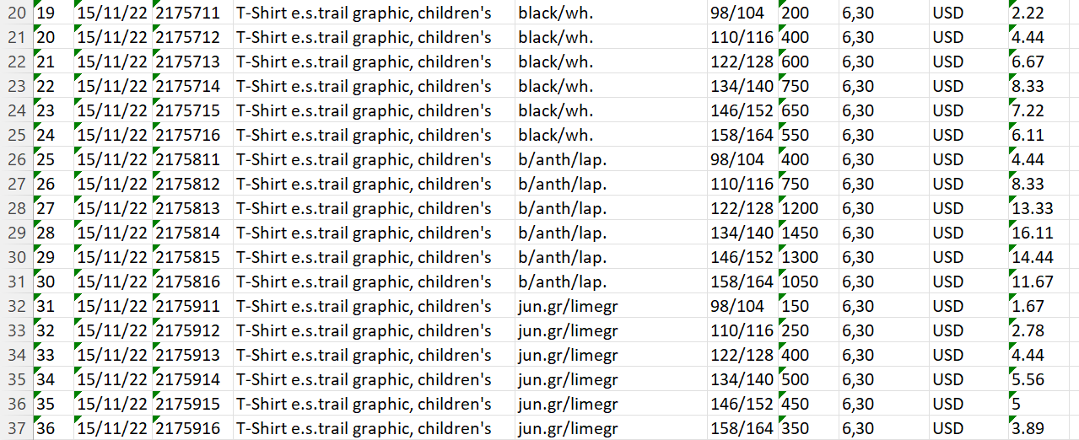
Find unique style
Get Unique style
Understand how many styles
Check common use of strings in different way
Check common use of strings in different way
We are researching if different string with same meaning used. Such as Children & Kids

Slide 6
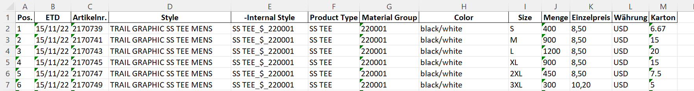
Determine Material Group & Product Type
Metadata of Material Group & Product type
Search every word of style string in the metadata
Get the best possible match and map it
If no product type mentioned, considering it as MEN

Slide 7
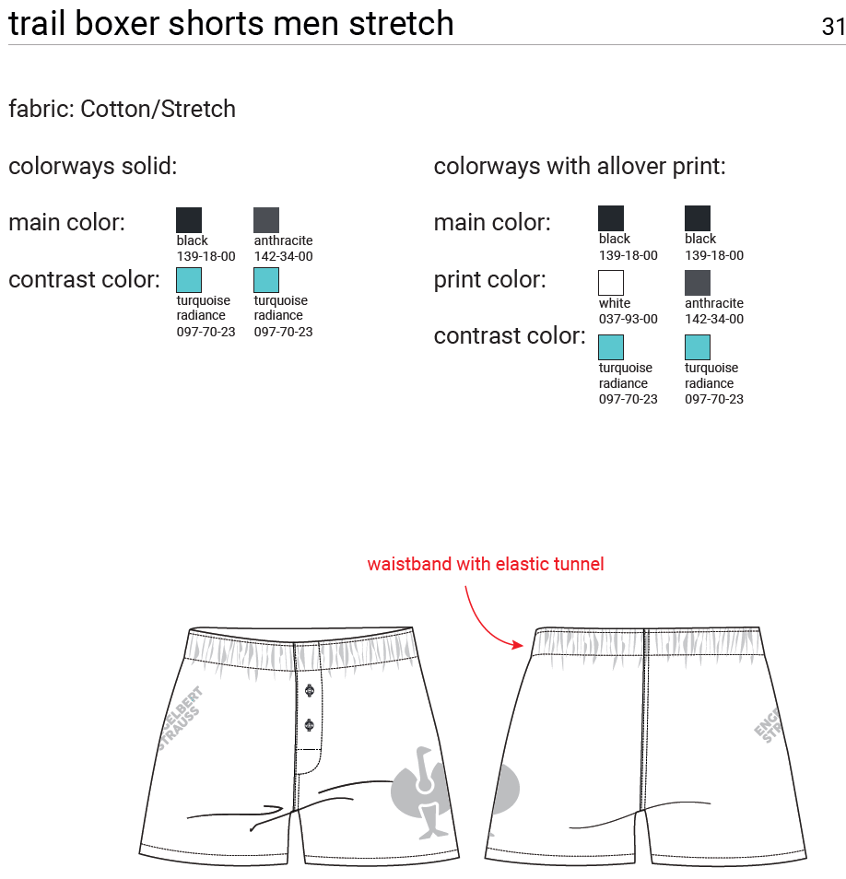
Reading techpack – 2nd PDF as input
Use PDF as input and AI to detect colours
Cut the PDF section into image by using image processing method of bounding box
Read the colour combinations mentioned

Slide 8
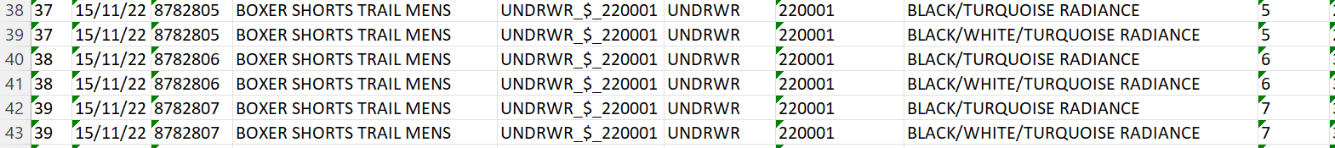
Detail out the Colour
Map every abbreviation of the colour
Use fuzzy matching to map the colours from Tech Pack
If not matched, we will check after matching all that if every side 1 abbreviation and 1 unmatched colour is there. If yes, we will consider it as matched. Else we will keep the abbreviation

Slide 9
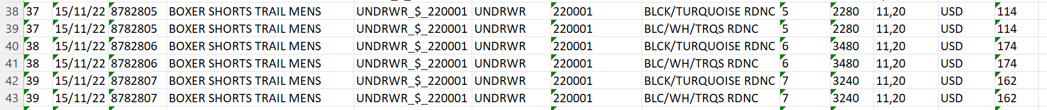
Detail out the Colour
SAP allows 16 characters in Colour & Size
We Kept 16 characters in colour and 8 in size
The colour code shortening done through skipping vowels from right hand side. If still we don’t match it 16 char, we truncate every string the best possible length
Notes:
Style – 15, Colour – 18, Size – 10 = 43 (Individual) But total character length is not more than 36 |

Slide 10
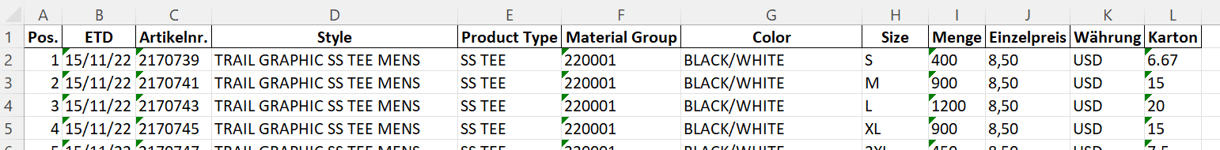
Style naming convention
Words meaning connected to product type & material group deleted
Exact description of product type & material group added to style
A metadata created to identify unnecessary words like “e.s.”, “cotton”, “stretch”. This metadata will have user input till now

Slide 11
Way forward to skip Azure cost
We are researching on using AI image processing technique
It will detect required section by boundary box
Convert the specific section into image
Check whether image looks like a table then apply table boundaries of rows/columns
Read the text of every cell with OCR Python library

Slide 12
Thank You

